Slide 2
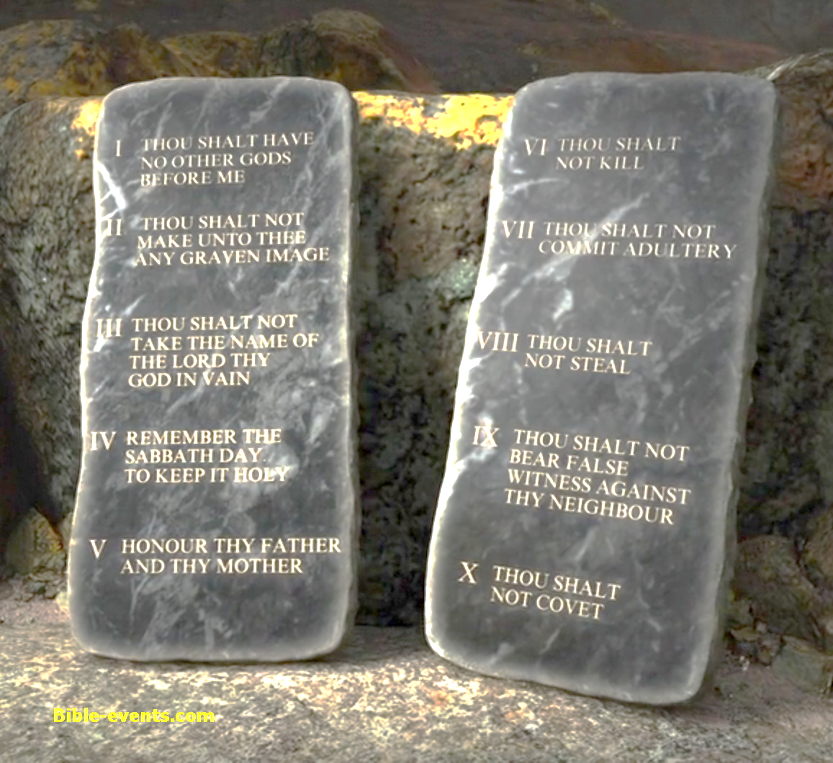
Value of the Old Testament Today
Romans 15:4;
1 Corinthians 10:6,11
biblestudylessons.com

Slide 3
Value of the Old Testament Today
Inspired History

Slide 4
History of God’s Dealings with Man
Beginning of Earth and the Human Race
Hebrews 11:3
God’s Relations with Men in Times Past
Hebrews 11; Acts 7

Slide 5
Value of the Old Testament Today
Inspired History
Evidence

Slide 6
Evidences to Support Our Faith
Evidence that God Exists and
that Jehovah is the One True God
Isaiah 41:21,22
Evidence that the Bible is the Word of God
Fulfilled prophecy
Unity of Bible writers
Evidence that Jesus is the Christ, the Son of God
John 5:39; Acts 17:2,3

Slide 7
Value of the Old Testament Today
Inspired History
Evidence
Unchanging Principles

Slide 8
Unchanging Principles
The Nature of God
Hebrews 13:8
The Nature and Needs of Man
Romans 3:10-18,23; Acts 7; 1 Corinthians 10:1-13

Slide 9
Value of the Old Testament Today
Inspired History
Evidence
Unchanging Principles
Appreciation & Understanding of the New Testament

Slide 10
Appreciation & Understanding of New Testament
Old Testament Prophecies May Explain
New Testament Concepts.
Isaiah 53; Acts 8:35; 15:15-18; Hebrews 7:11-18
The Contrast Between the Testaments Helps Us Appreciate the New Testament
Romans 3:20; Galatians 3:19-25
The Similarity Between the Testaments Helps Us Understand the New Testament
James 2:10-12; Hebrews 11
Idolatry - Exodus 32:4-6
Rules of Bible interpretation and Bible authority

Slide 11
Value of the Old Testament Today
Inspired History
Evidence
Unchanging Principles
Appreciation & Understanding of the New Testament
2 Timothy 3:16,17
Do we appreciate the value of all Scripture?
Do we apply it properly?

Slide 13
© Copyright David E. Pratte, 2025
Permission is granted to display this PowerPoint under the following conditions:
* Display the link to BibleStudyLessons.com
* Minor changes in content are permitted, but no teaching should be presented that disagrees with the teaching in the article associated with this PowerPoint at BibleStudyLessons.com/powerpoint
* In no case may a fee of any kind be charged for our PowerPoints.
* If you have a website, please add a link to BibleStudyLessons.com
Scripture quotations are generally from the New King James Version (NKJV), copyright 1982, 1988 by Thomas Nelson, Inc. Used by permission. All rights reserved.
biblestudylessons.com

