Slide 2
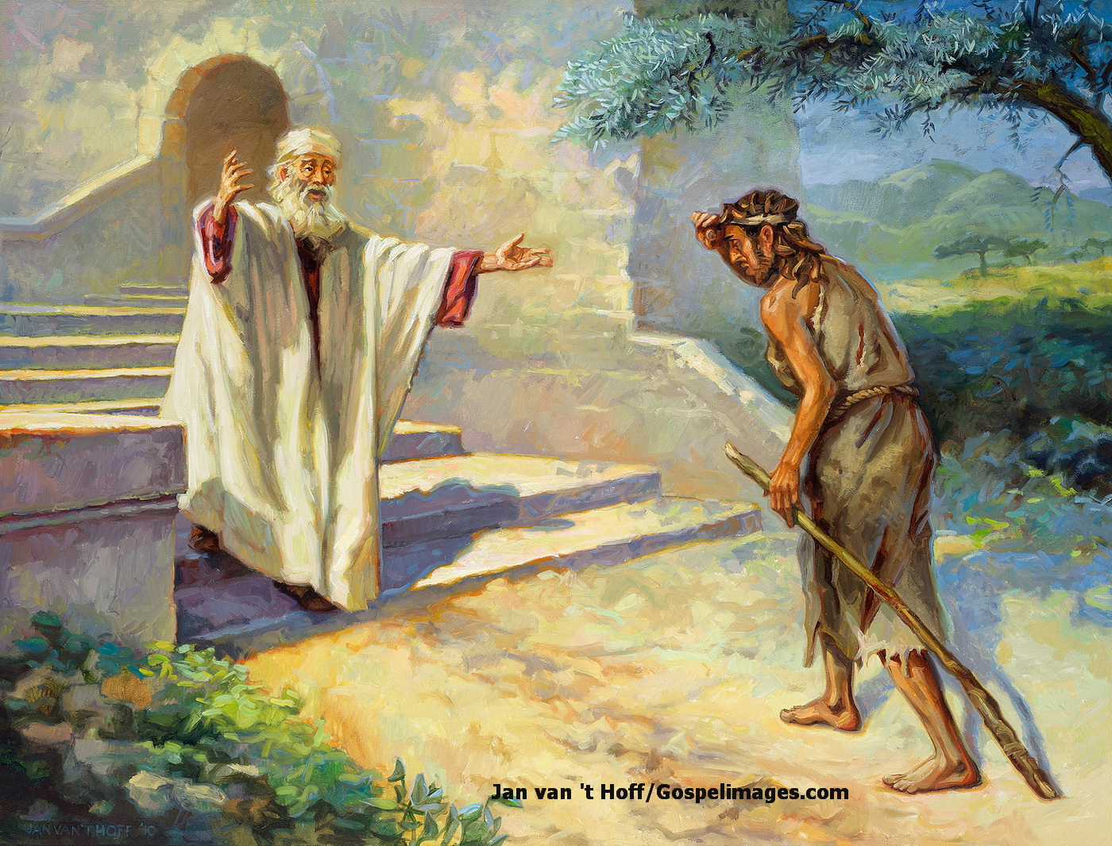
The Prodigal Son
Lessons learned from:
The Younger Son
biblestudylessons.com

Slide 3
Lessons from the Younger Son
Verses 11-19
A Child of God Can Fall Away
2 Peter 2:20-22; Galatians 5:1-4;
Acts 8:12-24
Returning Requires Repentance, Confession, & Obedience
Acts 2:38; 8:22; 2 Corinthians 7:10;
Psalms 38:18; 1 John 1:9; Matthew 5:23,24; Acts 26:20; Proverbs 28:13

Slide 4
The Prodigal Son
Lessons learned from:
The Younger Son
The Father

Slide 5
Lessons from the Father
Verses 20-24
God Wants His Children Saved
Luke 15:1-10; Mark 16:15,16;
2 Peter 3:9; John 3:16
God Grants Us Power to Choose
Joshua 24:15; Revelation 22:17;
Mark 16:15,16; Romans 2:6-11
God Allows Us to Suffer for Sin
Verse 16; 2 Thessalonians 3:10

Slide 6
The Prodigal Son
Lessons learned from:
The Younger Son
The Father
The Older Son

Slide 7
Lessons from the Older Son
Verses 25-32
Unloving toward the Lost
Verse 29,30; 1 Corinthians 13:1-3
1 Timothy 2:4,6; Titus 2:11;
2 Peter 3:9; Mark 16:15,16
Unforgiving
Matthew 6:12,14,15; 18:21-35
Disobedient and Self-Righteous
Verse 28; 1 John 4:20; Luke 18:9-14

Slide 8
The Prodigal Son
Where are you in your relationship to the Father?

Slide 9
© Copyright David E. Pratte, 2026
Permission is granted to display this PowerPoint under the following conditions:
* Display the link to BibleStudyLessons.com
* Minor changes in content are permitted, but no teaching should be presented that disagrees with the teaching in the article associated with this PowerPoint at BibleStudyLessons.com/powerpoint
* In no case may a fee of any kind be charged for our PowerPoints.
* If you have a website, please add a link to BibleStudyLessons.com
Scripture quotations are generally from the New King James Version (NKJV), copyright 1982, 1988 by Thomas Nelson, Inc. Used by permission. All rights reserved.
biblestudylessons.com

