Slide 2

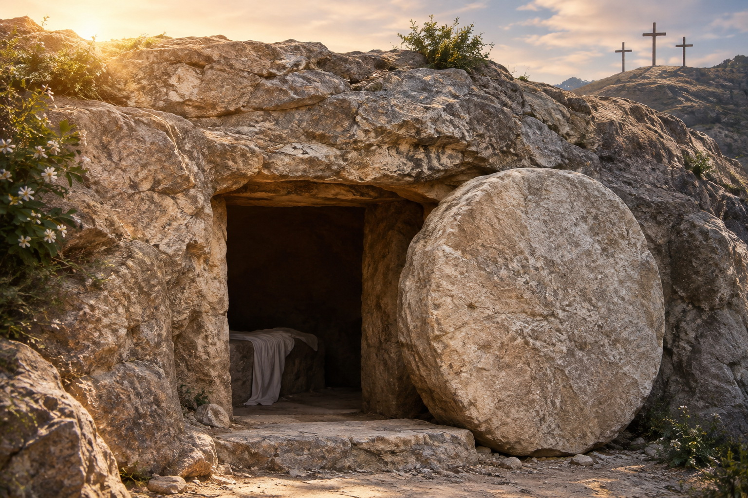
Resurrection: Factual Reality
Resurrection Events
Jesus’ Resurrection
Final Resurrection
biblestudylessons.com

Slide 3
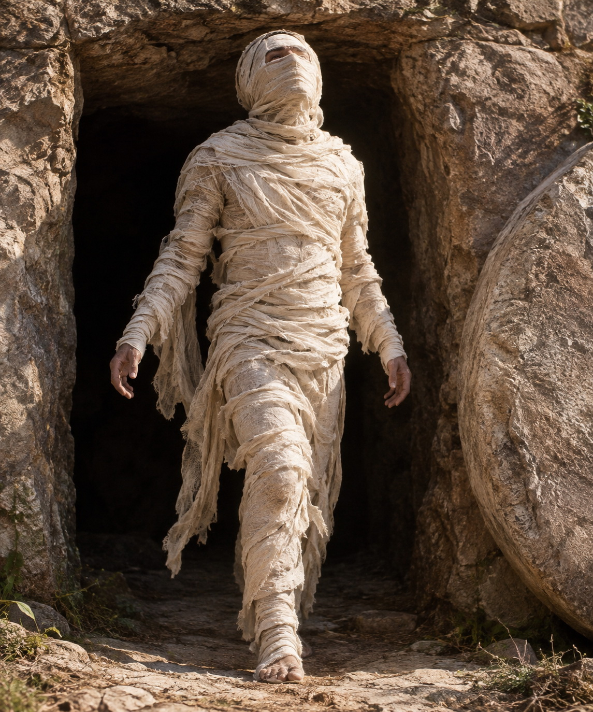
Facts: Resurrection Events
The widow’s son in Zarephath – 1 Kings 17:17–22
The Shunammite’s son – 2 Kings 4:32–37
The man in Elisha’s grave – 2 Kings 13:20,21
Jairus’ daughter – Luke 8:49-55
The widow’s son at Nain – Luke 7:11-17
Lazarus – John 11:23–44
People at Jesus’ crucifixion – Matthew 27:52,53
Dorcas – Acts 9:36-43
Eutychus – Acts 20:9-12
The Limited Commission – Matthew 10:8

Slide 4
Resurrection: Factual Reality
Resurrection Events
Jesus’ Resurrection
Final Resurrection

Slide 5
Fact: Jesus’ Resurrection
Predictions of Resurrection
Old Testament: Luke 24:46; Isaiah 53:7-10; Psalms 16:9,10
Jesus’ predictions: Matthew 16:21; 20:18,19
The empty tomb - Mark 16:5-7; John 20:1-9; Matthew 28:11-15
Eyewitness testimony - Acts 1:3; 1 Corinthians 15:3-8

Slide 6
Jesus’ Resurrection: Eyewitnesses
Angels – Matthew 28:1-8; Mark 16:5-7; Luke 24:4-7
Mary Magdalene – John 20:11-18; Mark 16:9-11
Other women – Matthew 28:9,10; Mark 16:1ff
Two disciples on the Emmaus road – Luke 24:13-35; Mark 16:12,13
Peter – Luke 24:34 (1 Corinthians 15:5)
All the apostles – Note Luke 24:36-43
Thomas with the apostles – John 20:24-31
James – 1 Corinthians 15:3-8
Over 500 brethren at once – 1 Corinthians 15:3-8
Jesus’ ascension – Acts 1:9-11 (Luke 24:50-53; Mark 16:19,20)
Joseph Barsabas and Matthias – Acts 1:21-23
Saul of Tarsus – Acts 9:1-9; 22:4-15; 26:9-18; 1 Cor. 9:1; 15:8,9

Slide 7
Jesus’ Resurrection
Predictions of Resurrection
Old Testament: Luke 24:46; Isaiah 53:7-10; Psalms 16:9,10
Jesus’ predictions: Matthew 16:21; 20:18,19
The empty tomb - Mark 16:5-7; John 20:1-9; Matthew 28:11-15
Eyewitness testimony - Acts 1:3; 1 Corinthians 15:3-8
The preaching of the apostles and early Christians
Apostles immediately proclaimed eyewitness testimony
The events were widely known - Note Acts 26:23,26
The apostles maintained their testimony despite opposition.
The testimony of the Bible

Slide 8
Resurrection: Factual Reality
Resurrection Events
Jesus’ Resurrection
Final Resurrection

Slide 9
Fact: Final Resurrection
Luke 20:27-39 - Jesus disproved those who denied resurrection.
1 Corinthians 15:20-26 - Jesus is the firstfruits from the dead.
1 Thessalonians 4:13-18 - He will raise the dead at His return.
General statements
1 Corinthians 6:14 – God both raised up the Lord and will raise us.
2 Corinthians 4:14 – He who raised up Jesus will also raise us up.
John 5:28-29 – All in the graves will hear His voice and come forth: resurrection of life or resurrection of condemnation.
John 6:40,44,45 – Jesus will raise at the last day those who believe
Acts 24:15 – Resurrection of the dead, both just and unjust.

Slide 10
Resurrection: Factual Reality
Resurrection Events
Jesus’ Resurrection
Final Resurrection

Slide 12
© Copyright David E. Pratte, 2026
Permission is granted to display this PowerPoint under the following conditions:
* Display the link to BibleStudyLessons.com
* Minor changes in content are permitted, but no teaching should be presented that disagrees with the teaching in the article associated with this PowerPoint at BibleStudyLessons.com/powerpoint
* In no case may a fee of any kind be charged for our PowerPoints.
* If you have a website, please add a link to BibleStudyLessons.com
Scripture quotations are generally from the New King James Version (NKJV), copyright 1982, 1988 by Thomas Nelson, Inc. Used by permission. All rights reserved.
biblestudylessons.com

